Slide 1

Index (x): Prescriptions for Performance Improvement
Find presentation, Excel spreadsheet, & T-SQL code at
https://github.com/SQLXL/SQLXL
Bill Sanscrainte
Bill@Sanscrainte.com
Notes:
*00:00*

Slide 2

Hi Ho, Hi Ho, it’s off
to work we go

Slide 3



Scan the QR code to submit session evaluations.

Slide 4

Realizing your index suggestions make you the new owner of future performance issues

Slide 5






















SQL Saturday Baton Rouge 2024
Thank you, Sponsors!

Slide 6

Finally granted admin rights

Slide 7
Why are we here?
“Poorly designed indexes and a lack of indexes are primary sources of database application
bottlenecks”
learn.microsoft.com 04/04/2023
Notes:
01:00/00:30
Microsoft says it best - It’s all about the indexes

Slide 8

When developers learn how poor indexes lead to resource semaphore waits

Slide 9
Session Synopsis - 1
There are 1000’s of SQL community scripts to make indexes better.
But who has time to find and run a thousand scripts?

Slide 10

After adding a covering index and the app is smoking

Slide 11

Finding and fixing an annoying bug

Slide 12
Session Synopsis - 2
What if … there was a tool that could:
- Identify where SQL Server indexes “hurt”
- Finds the biggest pain management areas
- Prescribe actions to reduce the pain …
- Share hundreds of detailed diagnostics
- And present it all in Excel?

Slide 13

After setting up Ola Hallengren’s Maintenance Solution

Slide 14

After asking the developers to please document their code

Slide 15
Session Synopsis - 3
Introducing SQLXL_Index!
A new tool to make index tuning simpler and more comprehensive for SQL developers and administrators.

Slide 16

When the performance improvement plan finally comes together

Slide 17

When 2nd level insists restarting SQL Server will fix the problem

Slide 18
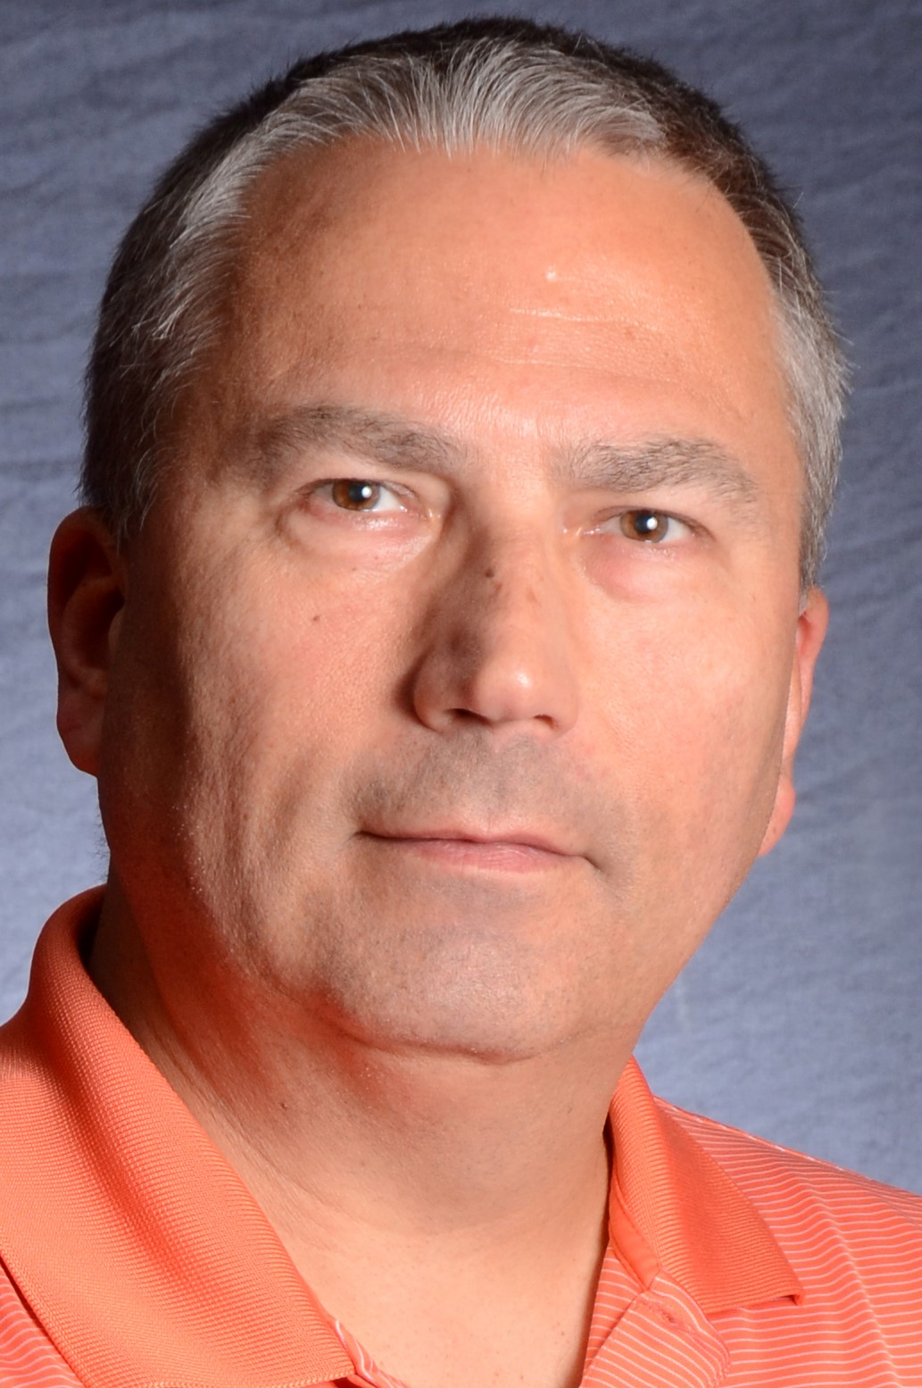
About Me
Bill Sanscrainte linkedin.com/in/billsanscrainte Bill@Sanscrainte.com
SQL Server since 6.5
1984 - Executed first SQL statement leading first data warehouse project
1994 - Started Data Consulting practice
2001 - Began version 1 of SQLXL tools
2020 - Retired to pursue passion projects
Record holder for most SQL Cruises as a student SQL Server 10, Oracle 2

Slide 19
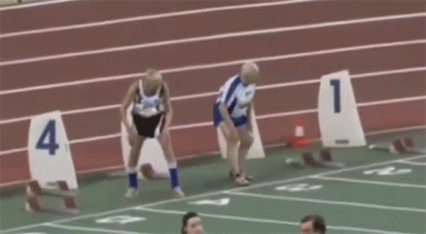
When the CFO insists you can get another year from your servers

Slide 20

Just as the CFO goes to close the books

Slide 21

Special thanks to these and other SQL community contributors!
Brent Ozar Kevin Kline Jes Borland Tom Collins Erik Darling Glenn Berry Gail Shaw Pedro Lopes Dave Bland | Tim Ford Sean McCown Kendra Little Pinal Dave Phil Factor Kalen Delaney Jason Strate Jared Westover Percy Reyes | Grant Fritchey Andy Yun Paul Randall Kimberly Tripp Edward Pollack Ahmad Yaseen Evgeniy Gribkov Ola Hallengren Denny Cherry | Aaron Bertrand Jonathan Kehayias Dmitri Korotkevitch Niko Neugebauer Monica Rathbun Kendall vanDyke Thomas LaRock Torsten Strauß Rebecca Hirschfield
Notes:
Shout out to these and others whose community contributions went into this presentation
Future Adds:
Jared Westover
Pedro Lopes (MS)

Slide 22

After installing new hardware

Slide 23

When the business requirements don’t make sense

